Slide 1
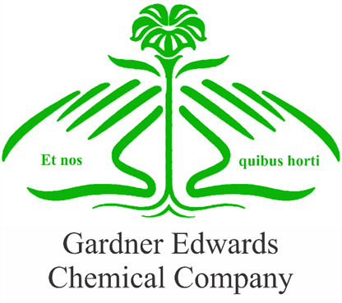
Gardner Edwards Chemical Co. [project title]
OBJECTIVES: | CONCLUSIONS and RECOMMENDATIONS:
APPROACH: | [Graphical Result]

Slide 2
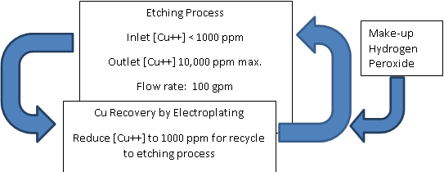
Gardner Edwards Chemical Co. Cu Recovery via Electroplating
OBJECTIVES: Determine if electroplating can be used to lower copper content in etchant waste to acceptable levels Determine if sales of recovered copper will be sufficient for new process to pay for itself. | CONCLUSIONS and RECOMMENDATIONS: Process appears feasible and profitable Estimated payback period is 4 months Effluent stream will meet environmental regulations Capital investment of $2.1 MM required Immediate construction recommended
APPROACH: Pilot plant used to determine plating characteristics Limiting current vs flow rate Cu plating kinetics Pilot results used to design full scale process Cell design and flow rate optimized Capital and operating costs considered | Schematic of Proposed Electroplating Process

